Slide 1
Healthcare Data Analysis
A Data-Driven Insight into Patient Admissions, Billing, and Medical Conditions
Presented by: Ruth Yakubu
Application Used: SQL, Power BI, Excel

Slide 2
Project Overview
This synthetic healthcare dataset has been created to serve as a valuable resource for data science, machine learning, and data analysis enthusiasts. It is designed to mimic real-world healthcare data, enabling users to practice, develop, and showcase their data manipulation and analysis skills in the context of the healthcare industry.

Slide 3
Objective
Objective: Explore and visualize healthcare data to uncover insights.
Data Source: Kaggle healthcare dataset.
Application: SQL (analysis), Power BI (dashboard), Excel (preprocessing).

Slide 4
Data Cleaning Process
Replaced column header spaces with underscores.
Ensured consistent data types for dates and numeric fields.
Handled missing/null values appropriately.

Slide 5
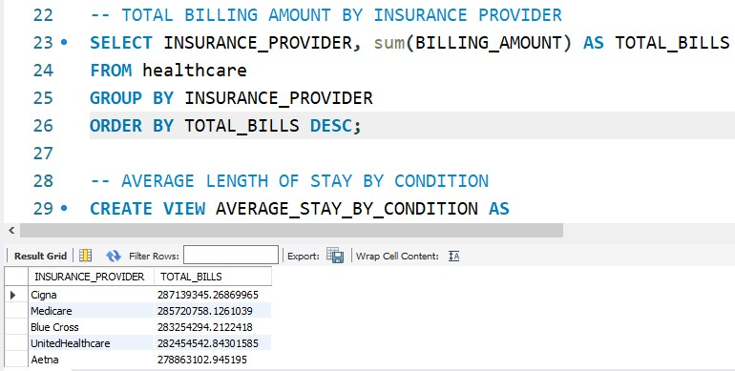
SQL Analysis – Billing by Insurance Provider
Query aggregated BILLING_AMOUNT by INSURANCE_PROVIDER.
Top 5 Providers:
Cigna – 287.19M
Medicare – 285.72M
Blue Cross – 283.25M
UnitedHealthcare –282.45M
Aetna – 278.86M
INSIGHT: Cigna leads in billing.

Slide 6
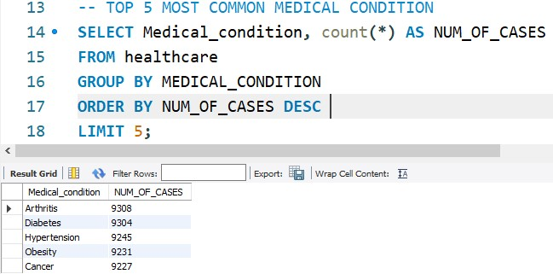
SQL Analysis – Common Medical Condition
Most Common Medical Condition:
Top 5 Condition:
Arthritis – 9308
Cancer – 9227
Diabetes – 9304
Hypertension- 9245
Obesity – 9231
INSIGHT: This shows the top medical condition is Arthritis

Slide 7
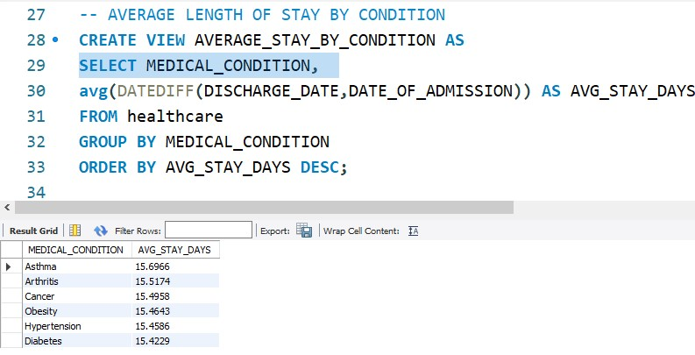
SQL Analysis – Average Stay by Condition
Calculated average stay using DATEDIFF between discharge and admission.
Top Conditions:
Asthma: 15.69 days
Arthritis: 15.52 days
Cancer: 15.50 days
Obesity: 15.46 days
Hypertension: 15.46 days
Diabetes: 15.42 days
INSIGHT: Asthma has the longest average stay.

Slide 8
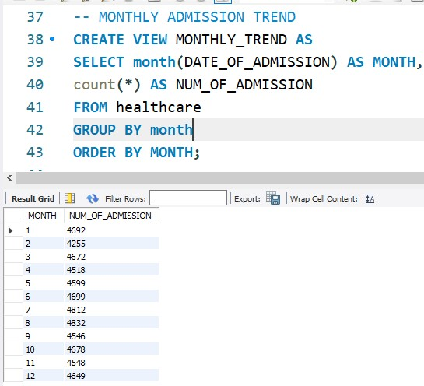
SQL Analysis – Monthly Admission Trend
Calculated the date of admission and number of admission.
This indicate that the first month on which patients were admitted to the healthcare facility was the highest, with a number of 4,692.

Slide 9
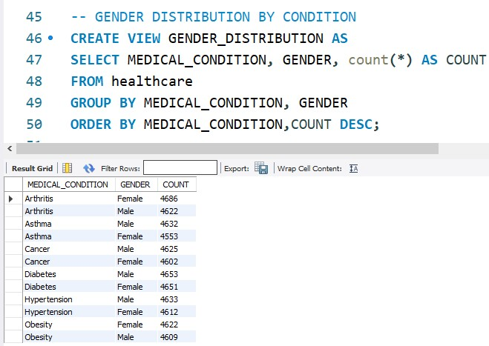
SQL Analysis – Gender Distribution by Condition
Distribution among genders is almost equal.
Conditions such as hypertension and diabetes seem to occur more often.

Slide 10
Power BI Dashboard Overview
Metrics Displayed:
Avg Stay Days: 93.06
Total Bills: 1.42 Billion
Number of Cases: 46K
Filters: Billing, Test Results, Condition, Gender, etc.

Slide 11
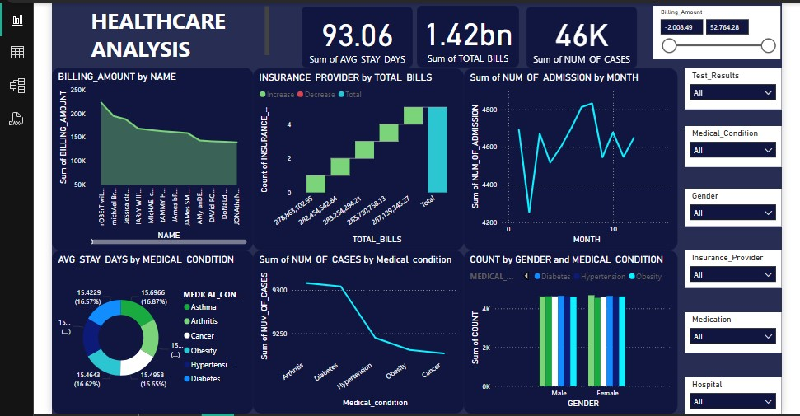

Slide 12
Key Visual Insights
Billing Amount by Name: 100K–250K range.
Insurance Breakdown: Cigna highest billing.
Admissions by Month: Peaks mid-year.

Slide 13
Conditions & Stay Duration
Pie chart shows average stay per condition.
Even distribution across conditions.
Asthma has a slightly longer stay.

Slide 14
Number of Cases vs Medical Condition
Arthritis & Hypertension: highest cases.
Cancer & Obesity: lower prevalence.

Slide 15
Gender & Condition Distribution
Near-equal gender distribution.
Hypertension and Diabetes are most common.

Slide 16
Conclusions & Business Implications
Cigna & Medicare handle high billing volumes.
Chronic conditions → longer stays.
Plan resources for peak admission months.

Slide 17
Recommendations
Optimize insurance processing.
Allocate resources for longer-stay conditions.
Monitor chronic condition recovery more closely.

Slide 18
Q&A
Feel free to ask questions or request clarifications.

Slide 19
Thank You
Connect with me:
GitHub: https://ruttysmith.github.io/Ruthyakubu.github.io/
LinkedIn: https://www.linkedin.com/in/ruthietheanalyst
Instagram: @ruthie.d.analyst_

